Slide 1
Parameter estimation Optimization
Lecture 2d

Slide 2
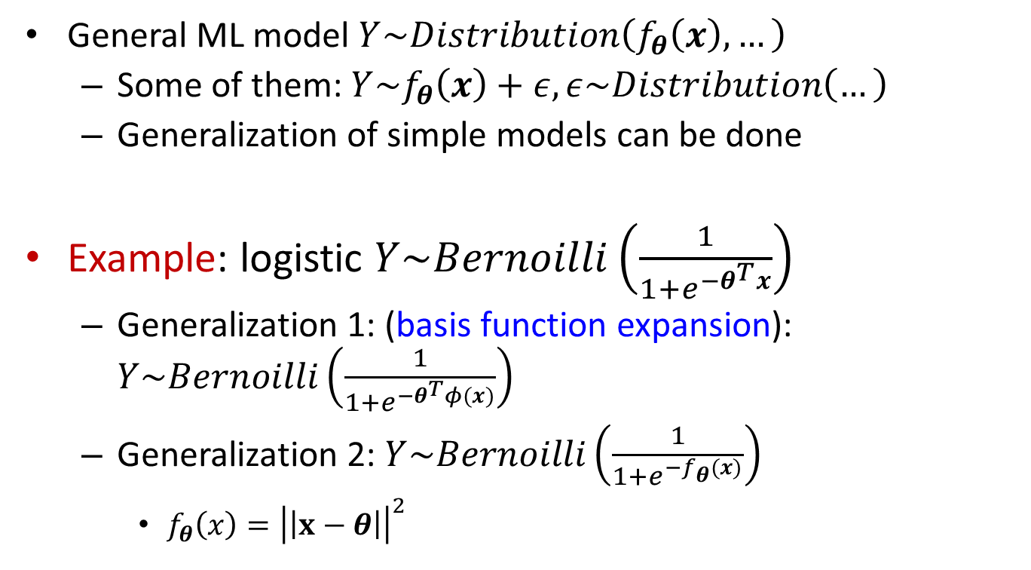
Parametric functions
General ML model $Y\sim Distribution\left(f_{θ}\left(x\right),…\right)$
Some of them: $Y\sim f_{θ}\left(x\right)+ε, ε\sim Distribution\left(…\right)$
Generalization of simple models can be done
Example: logistic $Y\sim Bernoilli\left(\frac{1}{1+e^{−θ^{T}x}}\right)$
Generalization 1: (basis function expansion): $Y\sim Bernoilli\left(\frac{1}{1+e^{−θ^{T}φ(x)}}\right)$
Generalization 2: $Y\sim Bernoilli\left(\frac{1}{1+e^{−f_{θ}(x)}}\right)$
$f_{θ}\left(x\right)={\left|\left|x−θ\right|\right|}^{2}$

Slide 3
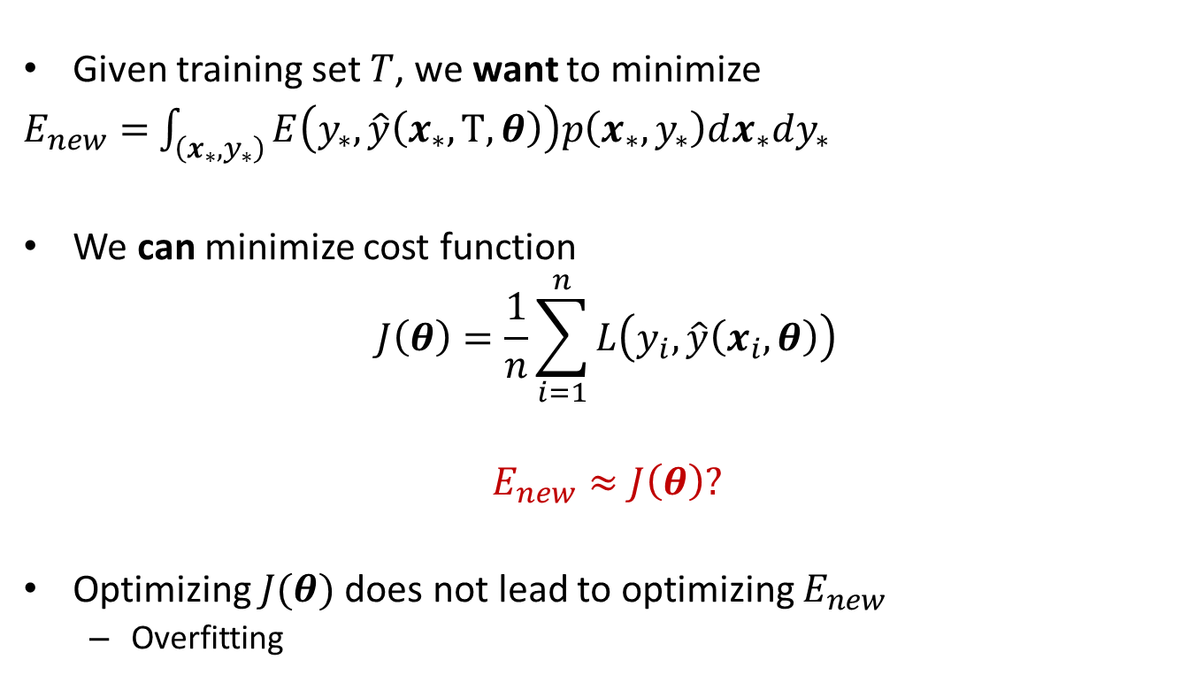
Loss minimization
Given training set $T$, we want to minimize
$E_{new}=$ $\int_{\left(x_{∗},y_{∗}\right)}{E\left(y_{∗},\hat{y}\left(x_{∗}, Τ, θ\right)\right)p\left(x_{∗},y_{∗}\right)dx_{∗}dy_{∗}}$
We can minimize cost function
$$J\left(θ\right)=\frac{1}{n}\sum_{i=1}^{n}{L\left(y_{i}, \hat{y}\left(x_{i}, θ\right)\right)}$$
$$E_{new}≈J\left(θ\right)?$$
Optimizing $J(θ)$ does not lead to optimizing $E_{new}$
Overfitting

Slide 4


Loss minimization: comments
Training a model with perfect accuracy unreasonable
Statistical noise for finite $n$
Loss function can be different from error function
Some loss functions are not good for training, for ex. misclassification rate.

Slide 5
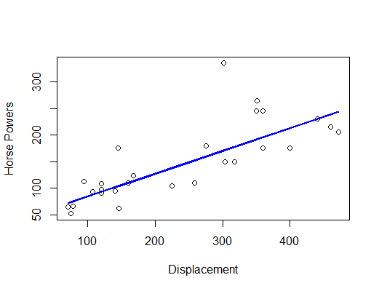

Loss functions
Assuming a distribution, derive as minus log-likelihood:
$y\sim Normal\left(f_{θ}\left(x\right), σ^{2}\right) →L\left(y, f_{θ}(x)\right)={\left(y−f_{θ}(x)\right)}^{2}$
Heavy outliers$y\sim Laplace\left(f_{θ}\left(x\right), r\right) →L\left(y, f_{θ}(x)\right)=|y−f_{θ}(x)|$

Slide 6
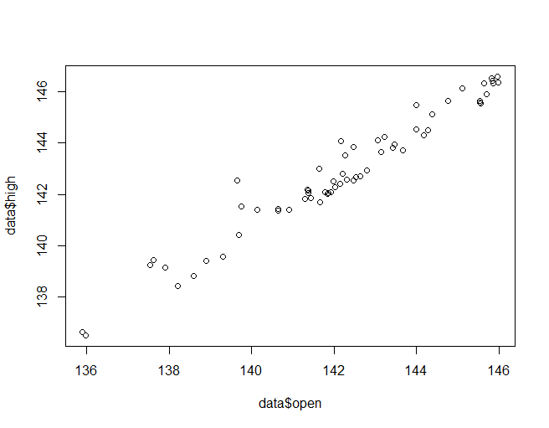
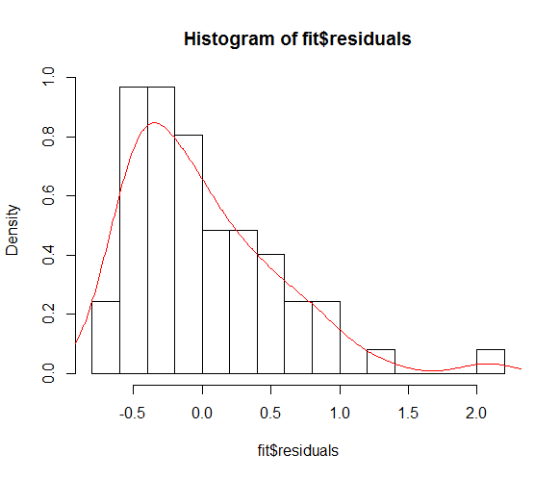
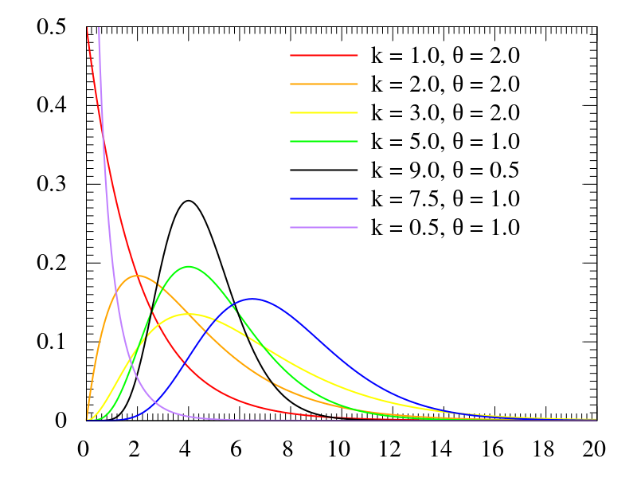

Loss functions
Count data $y\sim Poisson(f_{θ}\left(x\right))$
Example: Daily Stock prices NASDAQ
Open
High (within day)
Try to fit usual linear regression, study histogram of residuals

Slide 7
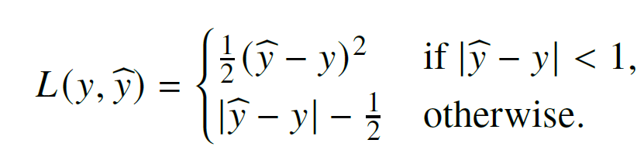
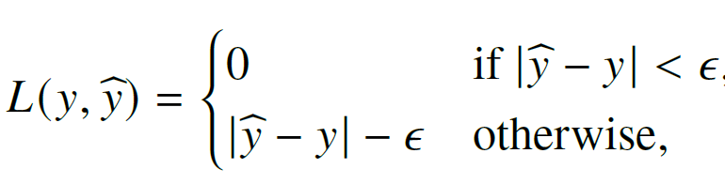
Loss functions
If the distribution is difficult to assume / only some properties known→ ad-hoc loss functions
Huber loss: similar to quadratic but robust to outliers
E-intensive loss

Slide 8
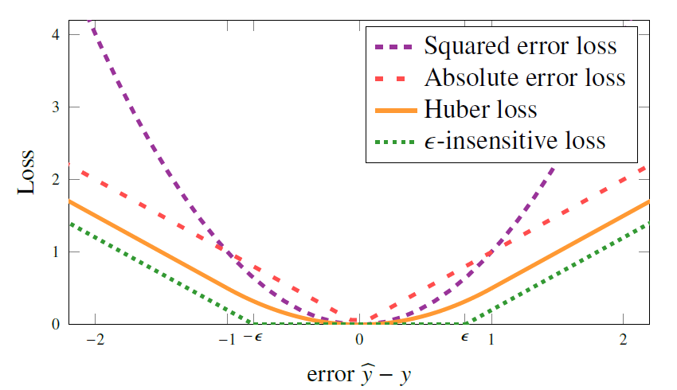
Loss functions

Slide 9
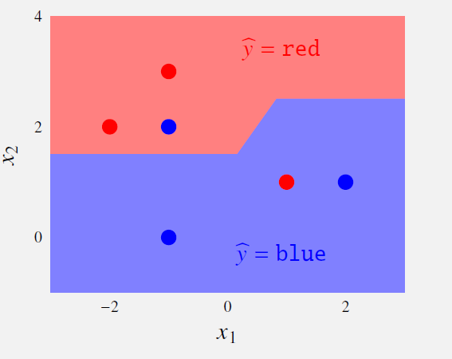
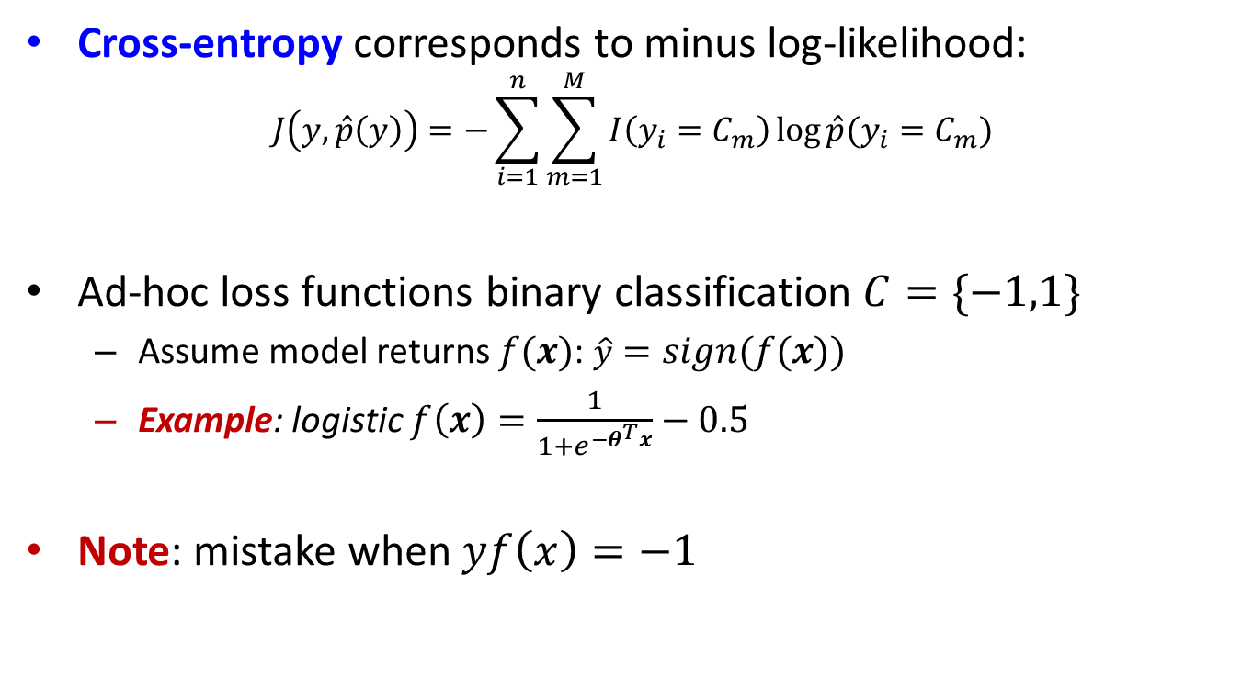
Loss functions: classification
Cross-entropy corresponds to minus log-likelihood:
$$J\left(y, \hat{p}\left(y\right)\right)=−\sum_{i=1}^{n}{\sum_{m=1}^{M}{I\left(y_{i}=C_{m}\right)\log{\hat{p}(y_{i}=C_{m})}}}$$
Ad-hoc loss functions binary classification $C=\{−1,1\}$
Assume model returns $f(x)$: $\hat{y}=sign(f\left(x\right))$
Example: logistic $f\left(x\right)=\frac{1}{1+e^{−θ^{T}x}}−0.5$
Note: mistake when $yf\left(x\right)=−1$

Slide 10
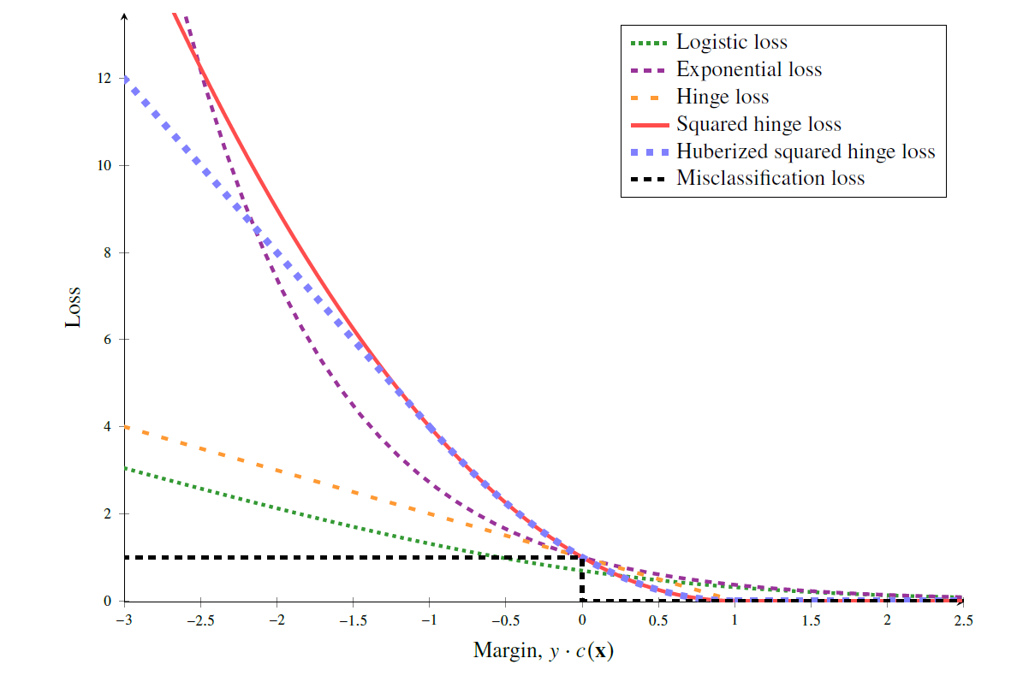
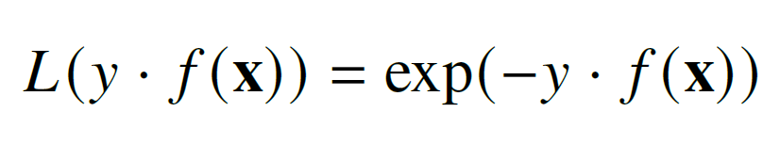
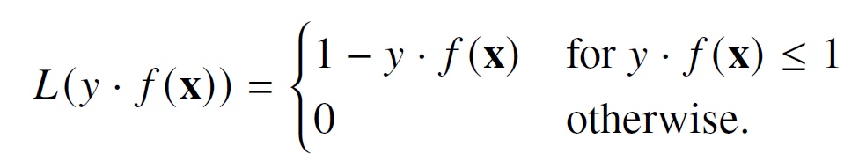
Loss functions: classification
Ad-hoc loss functions binary classification
Exponential loss
Hinge loss

Slide 11
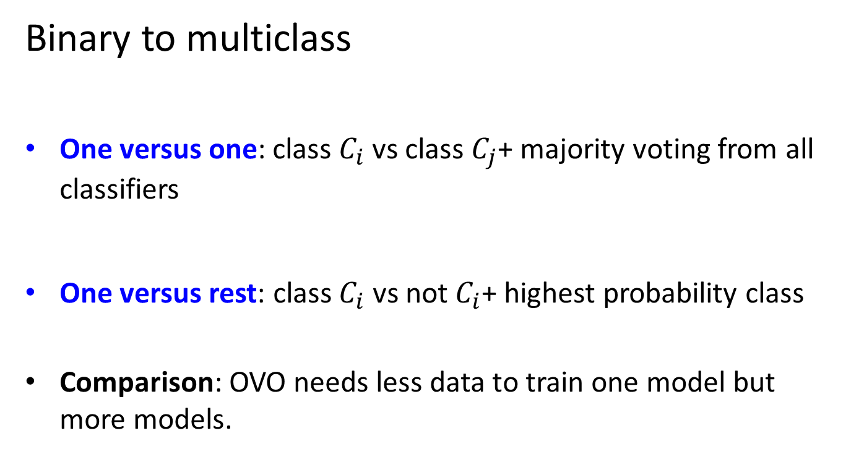
Loss functions: classification
Binary to multiclass
One versus one: class $C_{i}$ vs class $C_{j}$+ majority voting from all classifiers
One versus rest: class $C_{i}$ vs not $C_{i}$+ highest probability class
Comparison: OVO needs less data to train one model but more models.

Slide 12
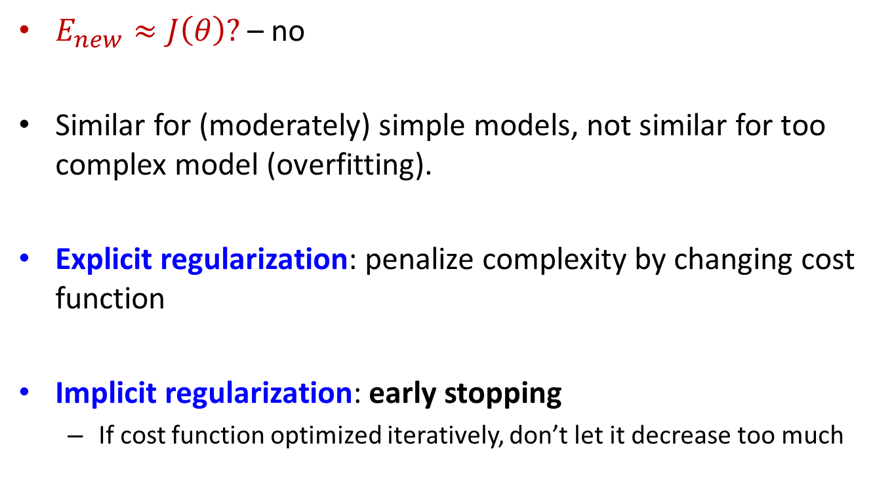
Regularization
$E_{new}≈J\left(θ\right)?$ – no
Similar for (moderately) simple models, not similar for too complex model (overfitting).
Explicit regularization: penalize complexity by changing cost function
Implicit regularization: early stopping
If cost function optimized iteratively, don’t let it decrease too much

Slide 13
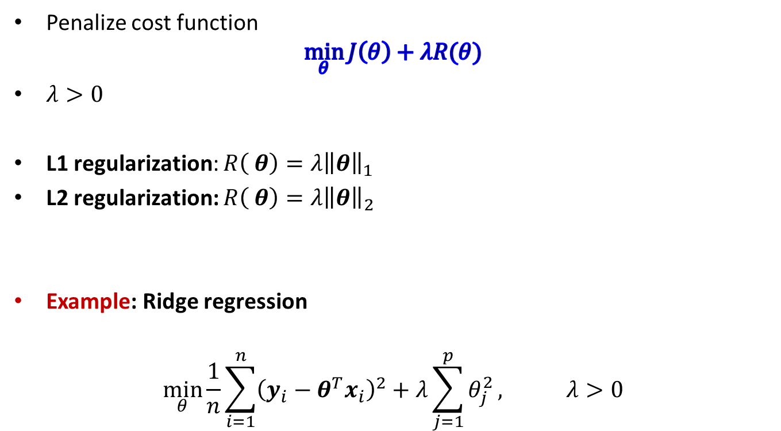
Explicit regularization
Penalize cost function
$$\min_{θ}{J\left(θ\right)+λR(θ)}$$
$λ>0$
L1 regularization: $R\left( θ\right)=λ{\left\|θ\right\|}_{1}$
L2 regularization: $R\left( θ\right)=λ{\left\|θ\right\|}_{2}$
Example: Ridge regression
$$\min_{θ}{\frac{1}{n}\sum_{i=1}^{n}{{\left(y_{i}−θ^{T}x_{i}\right)}^{2}+λ\sum_{j=1}^{p}{θ_{j}^{2}}}}, λ>0$$

Slide 14

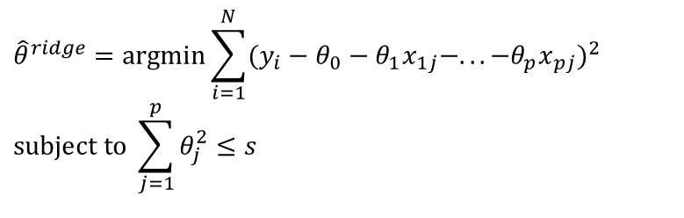
Explicit regularization: ridge regression
Equivalent form
Solution
$$θ^{ridge}={\left(X^{T}X+λI\right)}^{−1}X^{T}y$$
$${\hat{θ}}^{ridge}=\text{argmin}\sum_{i=1}^{N}{(y_{i}−θ_{0}−θ_{1}x_{1j}−...−θ_{p}x_{pj})^{2}} \\ subject to \sum_{j=1}^{p}{θ_{j}^{2}≤s}$$

Slide 15
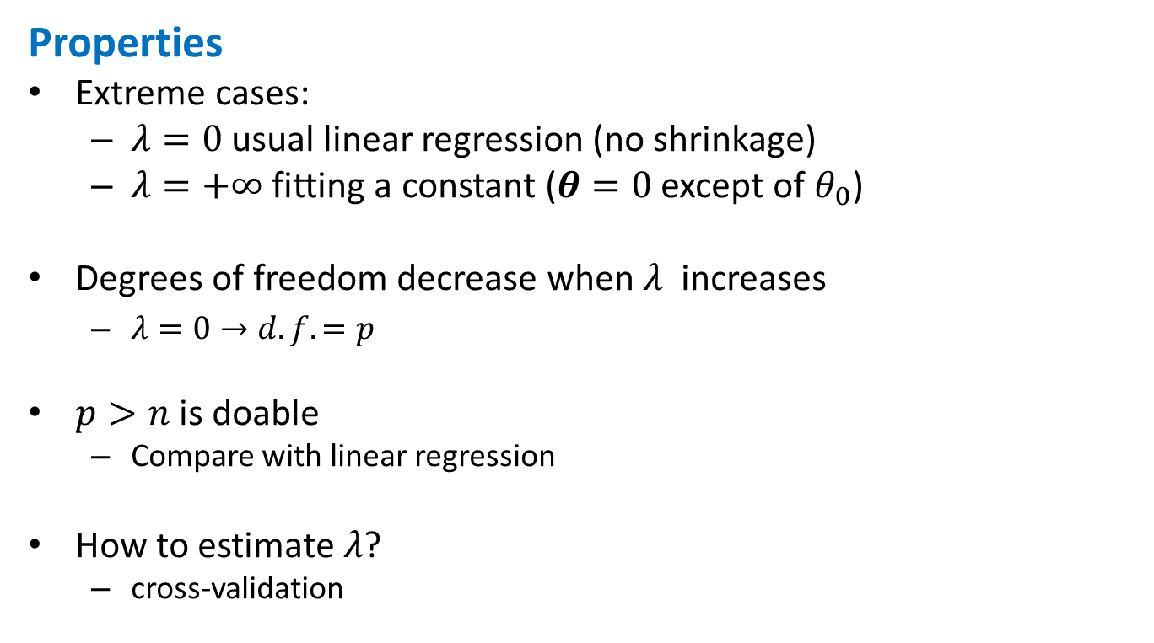
Ridge regression
Properties
Extreme cases:
$λ=0$ usual linear regression (no shrinkage)
$λ=+∞$ fitting a constant ($θ=0$ except of $θ_{0}$)
Degrees of freedom decrease when $λ$ increases
$λ=0→d.f.=p$
$p>n$ is doable
Compare with linear regression
How to estimate $λ$?
cross-validation

Slide 16

Ridge regression
Example Computer Hardware Data Set : performance measured for various processors and also
Cycle time
Memory
Channels
…
Build model predicting performance

Slide 17
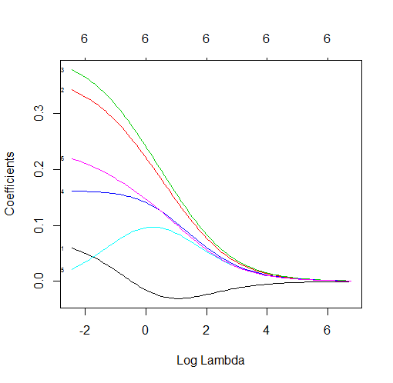
Ridge regression
R code: use package glmnet with alpha=0 (Ridge regression)
Seeing how Ridge converges
data=read.csv("machine.csv", header=F)
library(caret)
library(glmnet)
scaler=preProcess(data)
data1=predict(scaler, data)
covariates=data1[,3:8]
response=data1[, 9]
model0=glmnet(as.matrix(covariates), response, alpha=0,family="gaussian")
plot(model0, xvar="lambda", label=TRUE)

Slide 18
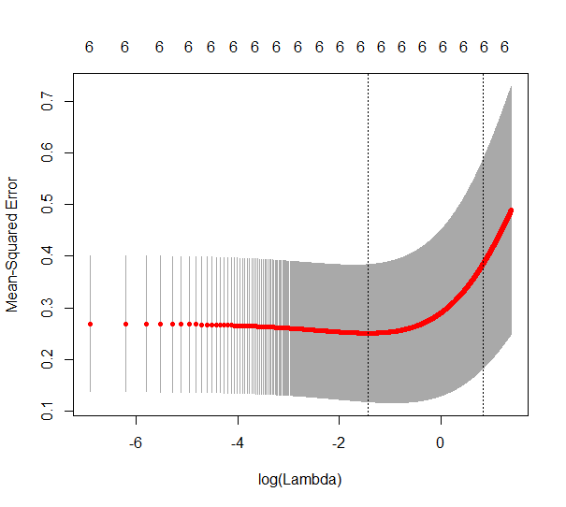
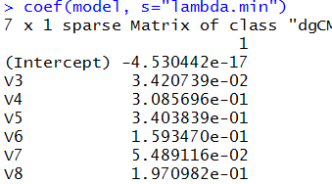
Ridge regression
Choosing the best model by cross-validation:
model=cv.glmnet(as.matrix(covariates), response, alpha=0,family="gaussian")
model$lambda.min
plot(model)
coef(model, s="lambda.min")
> model$lambda.min
[1] 0.046

Slide 19

Ridge regression
How good is this model in prediction?
covariates=train[,1:6]
response=train[, 7]
model=cv.glmnet(as.matrix(covariates), response, alpha=1,family="gaussian", lambda=seq(0,1,0.001))
y=test[,7]
ynew=predict(model, newx=as.matrix(test[, 1:6]), type="response")
#Coefficient of determination
sum((ynew-mean(y))^2)/sum((y-mean(y))^2)
sum((ynew-y)^2)
Note that data are so small so numbers change much for other train/test

Slide 20
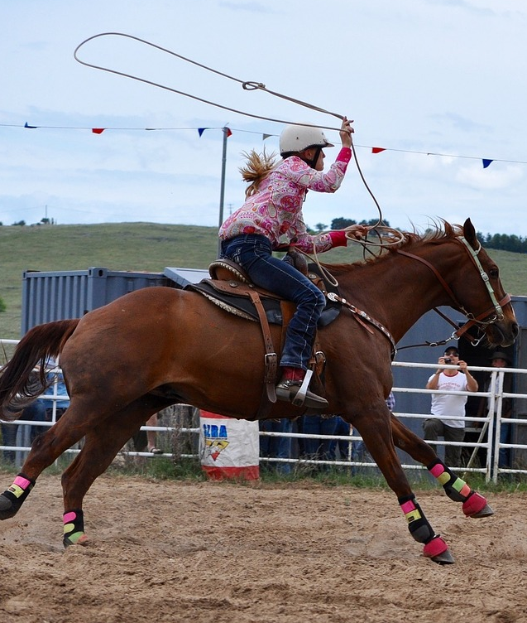
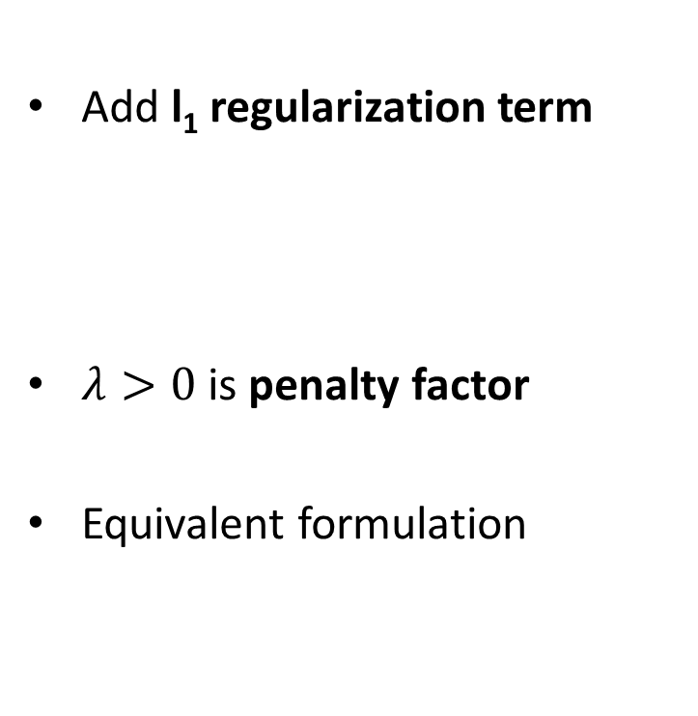
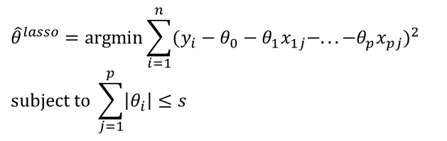
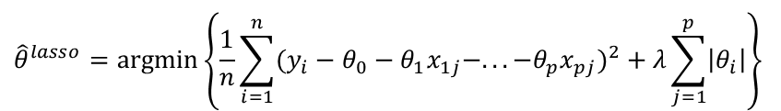
LASSO
Add l₁ regularization term
$λ>0$ is penalty factor
Equivalent formulation
$${\hat{θ}}^{lasso}=\text{argmin}\left\{\frac{1}{n}\sum_{i=1}^{n}{(y_{i}−θ_{0}−θ_{1}x_{1j}−...−θ_{p}x_{pj})^{2}+λ\sum_{j=1}^{p}{\left|θ_{i}\right|}}\right\}$$
$${\hat{θ}}^{lasso}=\text{argmin}\sum_{i=1}^{n}{(y_{i}−θ_{0}−θ_{1}x_{1j}−...−θ_{p}x_{pj})^{2}} \\ subject to \sum_{j=1}^{p}{\left|θ_{i}\right|≤s}$$
http://img-aws.ehowcdn.com

Slide 21
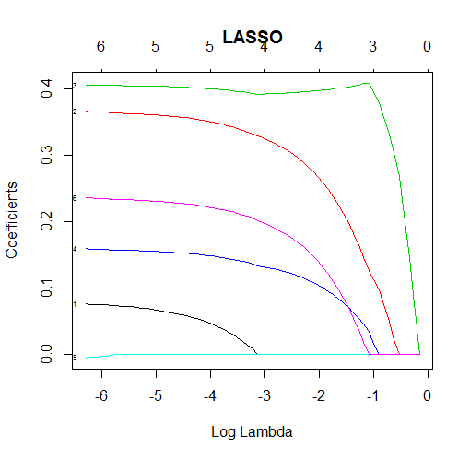
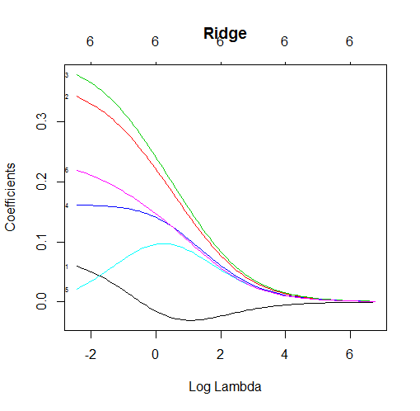
LASSO vs Ridge
LASSO yields sparse solutions!
Example Computer hardware data

Slide 22
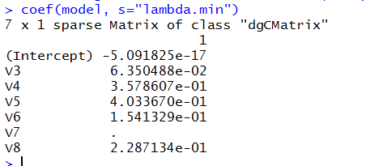

LASSO vs Ridge
In R, use glmnet with alpha=1
Only 5 variables selected by LASSO

Slide 23
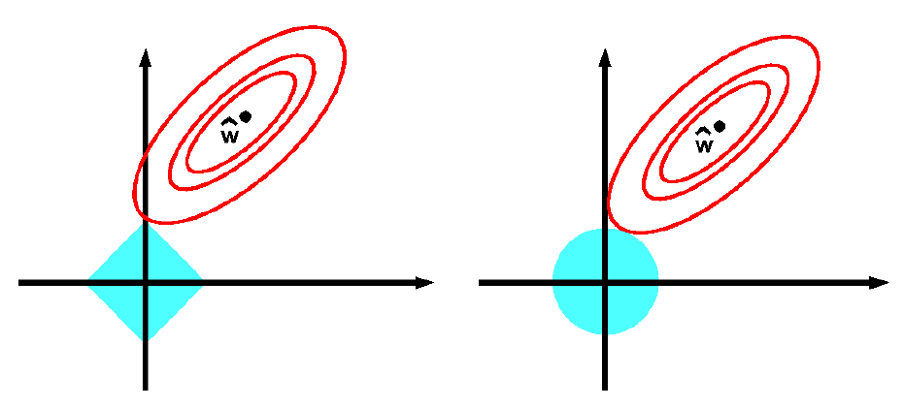

LASSO vs Ridge
Why Lasso leads to sparse solutions?
Feasible area for Ridge is a circle (2D)
Feasible area for LASSO is a polygon (2D)
$$\hat{θ}$$
$$\hat{θ}$$

Slide 24
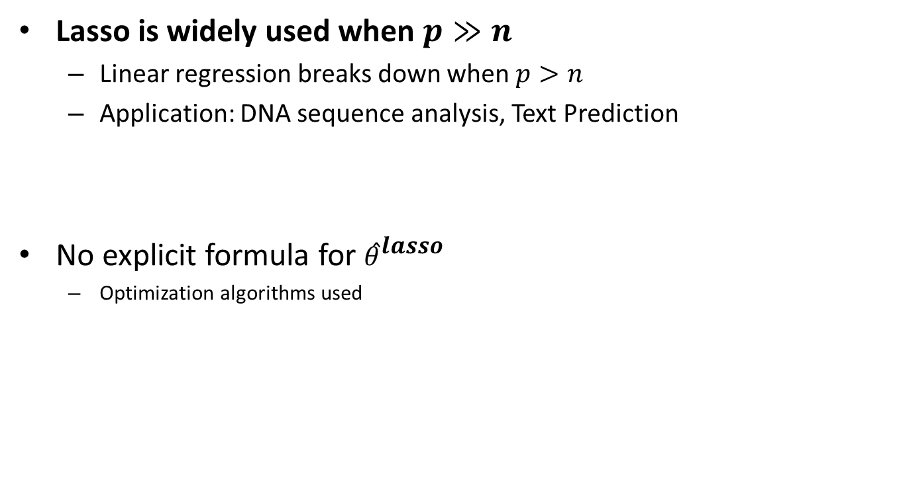
LASSO properies
Lasso is widely used when $p≫n$
Linear regression breaks down when $p>n$
Application: DNA sequence analysis, Text Prediction
No explicit formula for ${\hat{θ}}^{lasso}$
Optimization algorithms used

Slide 25
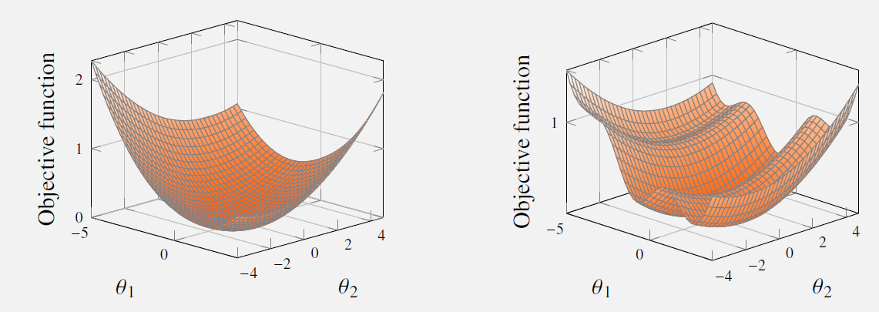

Optimization methods
Numerical optimization often needed
$$\min_{θ}{J(θ)}$$
$$\min_{λ}{E_{hold−out}}(λ)$$
If not convex objective, more than one local optimum

Slide 26

Optimization methods
Gradient descent method
$$\hat{θ}=\arg{\min_{θ}{J(θ)}}$$
Basic idea:
Start from some point $θ_{0}$
Move to the next point along descent direction $−∇_{θ}J(θ)$

Slide 27
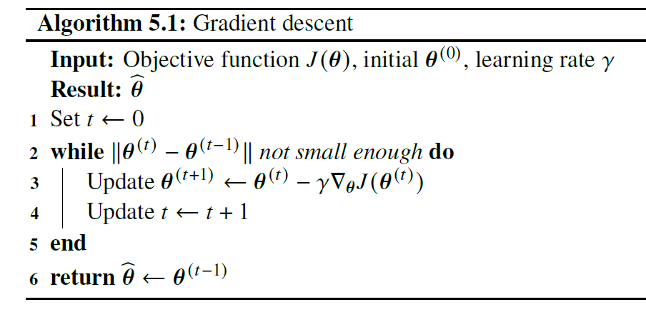
Gradient descent
Example: logistic regression

Slide 28

Gradient descent
Influence of $γ$
Trace $J\left(θ^{(t)}\right)$ vs $t$
High oscillation→decrease $γ$
Slow changes → increase $γ$
Try with different $θ^{(0)}$ if possible

Slide 29
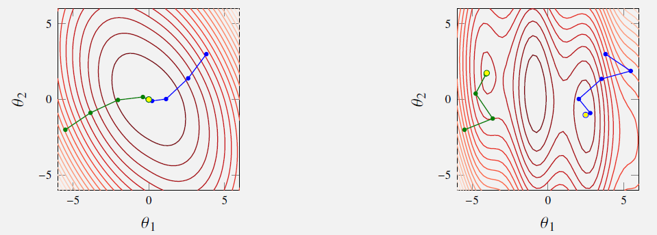

Newton’s method
Assume $J\left(θ\right)$ is ”locally” quadratic
Newton’s method: move along the best direction

Slide 30
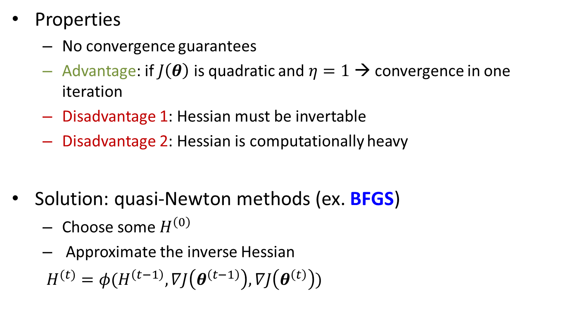
Newton’s method
Properties
No convergence guarantees
Advantage: if $J\left(θ\right)$ is quadratic and $η=1$ → convergence in one iteration
Disadvantage 1: Hessian must be invertable
Disadvantage 2: Hessian is computationally heavy
Solution: quasi-Newton methods (ex. BFGS)
Choose some $H^{\left(0\right)}$
Approximate the inverse Hessian
$H^{(t)}=φ(H^{\left(t−1\right)}, ∇J\left(θ^{\left(t−1\right)}\right),∇J\left(θ^{\left(t\right)}\right))$

Slide 31
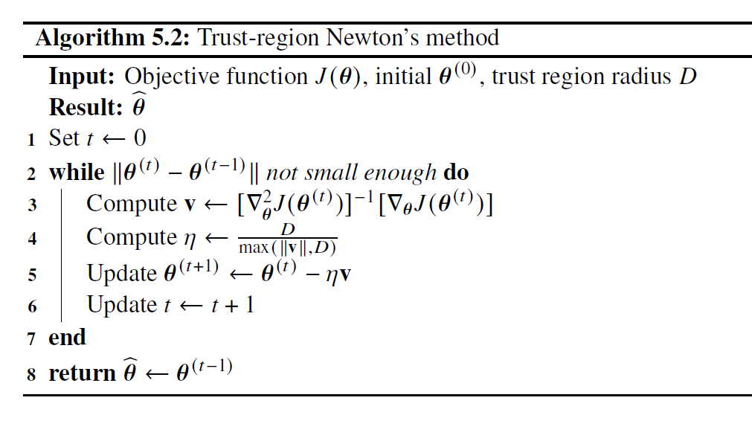
Newton’s method

Slide 32

Optimization methods in R
In R, use optim(par, fn, gr, method,…)
par: initial parameter vector
fn: function to optimize
gr: gradient function
method
Example: trace plot for $y={\left(x_{1}−2\right)}^{4}+{\left(x_{2}−4\right)}^{4}$

Slide 33
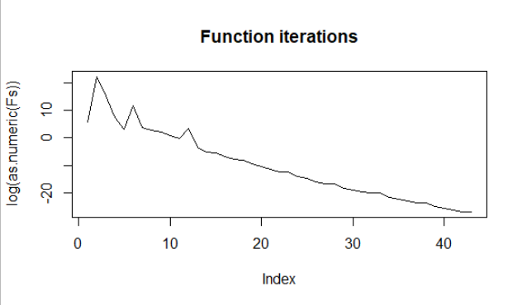
Optimization methods in R
#Workaround: optim does not return iterations
Fs=list()
Params=list()
k=0
myf<- function(x){
f=(x[1]-2)^4+(x[2]-4)^4
.GlobalEnv$k= .GlobalEnv$k+1
.GlobalEnv$Fs[[k]]=f
.GlobalEnv$Params[[k]]=x
return(f)
}
myGrad <-function(x) c(4*(x[1]-2)^3, 4*(x[2]-4)^3)
res<-optim(c(0,0), fn=myf, gr=myGrad, method="BFGS")
plot(log(as.numeric(Fs)), type="l", main="Function iterations")

Slide 34
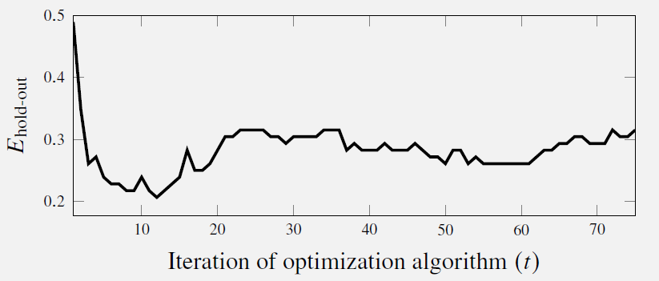

Implicit regularization
Early stopping
For complex models, accurate model optimization may lead to overfitting
Start from some parameter set (probably not optimal, large $E_{train}$ and $E_{new}$)
Trace the validation error (and training error? ) for each $t$
Choose model with the smallest validation error

Slide 35
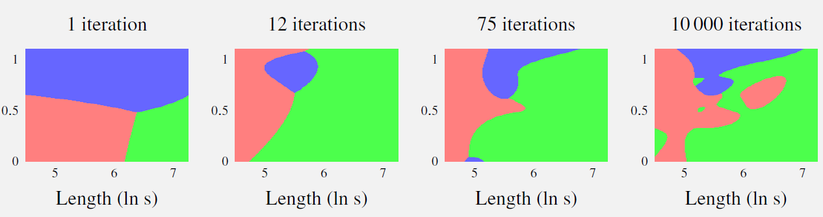
Implicit regularization

Slide 36
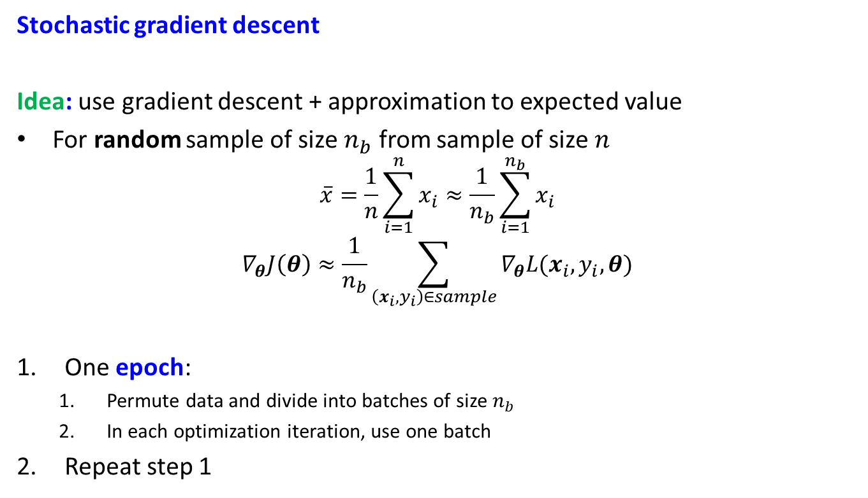
Optimization for large data
Stochastic gradient descent
Idea: use gradient descent + approximation to expected value
For random sample of size $n_{b}$ from sample of size $n$
$$\overline{x}=\frac{1}{n}\sum_{i=1}^{n}{x_{i}≈\frac{1}{n_{b}}\sum_{i=1}^{n_{b}}{x_{i}}}$$
$$∇_{θ}J\left(θ\right)≈\frac{1}{n_{b}}\sum_{\left(x_{i},y_{i}\right)∈sample}{∇_{θ}L(x_{i}, y_{i}, θ)}$$
One epoch:
Permute data and divide into batches of size $n_{b}$
In each optimization iteration, use one batch
Repeat step 1

Slide 37



Stochastic gradient descent
Different choices for $γ_{t}$, for ex

Slide 38


Hyperparameter optimization
$E_{hold−out}$ costly to compute→ usual optimization very hard
Note: for each $λ$ first we need to optimize $θ$…+ gradients of $E_{hold−out}$
Grid search (can also be costly)
Alternative: Bayesian optimization

